Slide 1
Welcome to
Total Quality Management
(19MEE347)
Unit 3 – Total Productive Maintenance
Name: Dr. Sunil Kumar
Department of Mechanical Engineering

Slide 2
Total Productive Maintenance (TPM)
TPM is a holistic approach to equipment maintenance that strives to achieve perfect production:
No Breakdowns
No Small Stops or Slow Running
No Defects
No Accidents
Getting operators involved in maintaining their own equipment and emphasising proactive and preventive maintenance will lay a foundation for improved production (fewer breakdowns, stops, and defects).

Slide 3
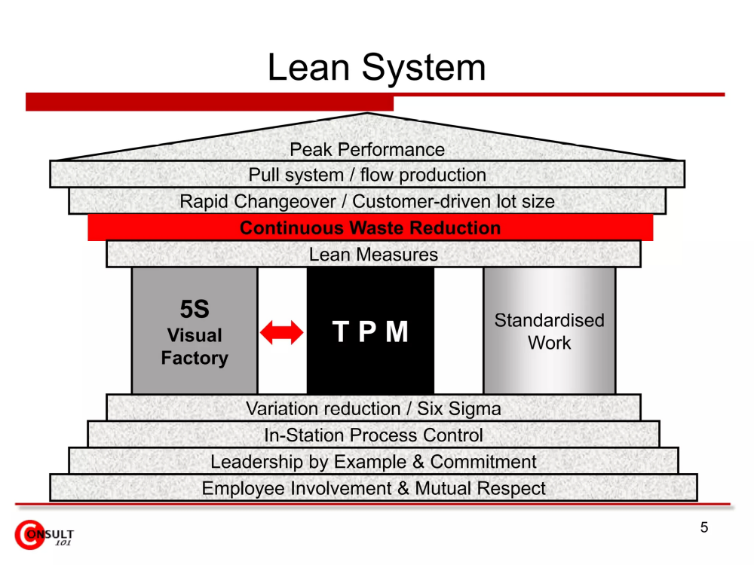
TPM - Overview
Lean System

Slide 4
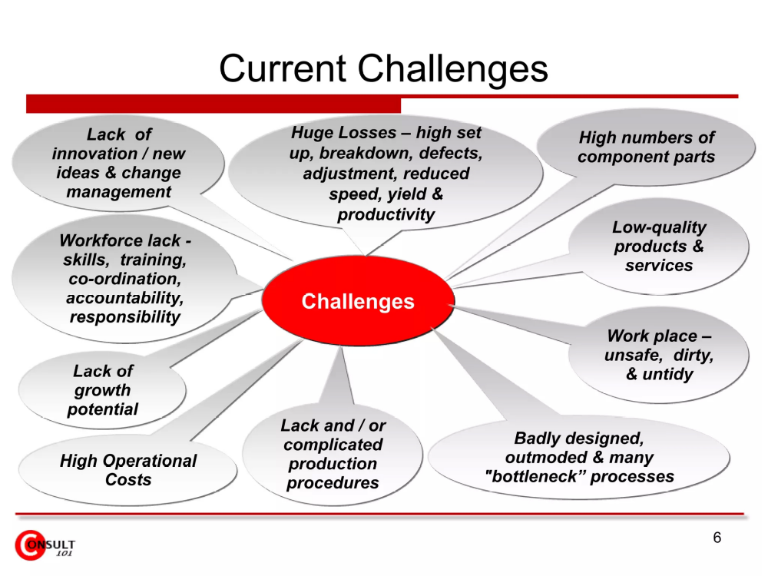
TPM - Overview
Current Challenges

Slide 5
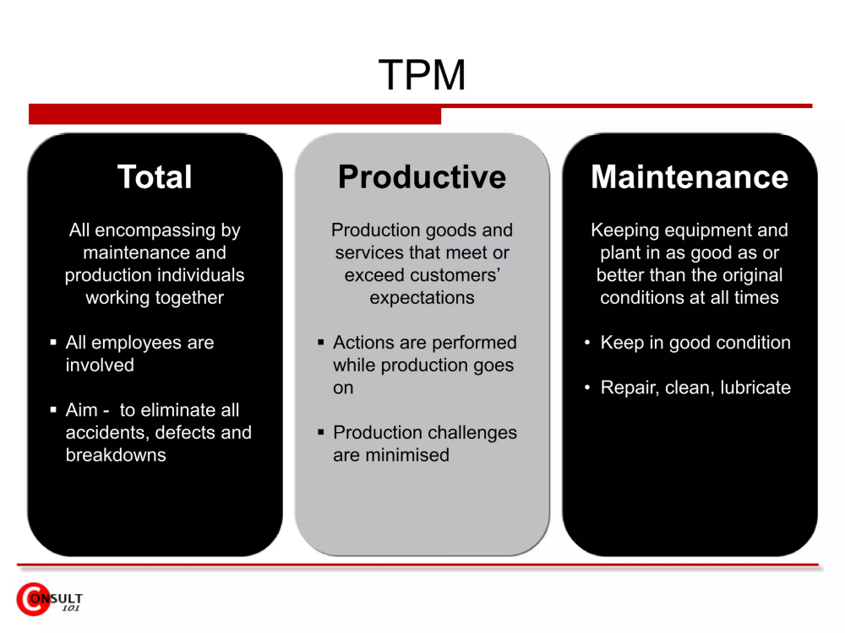
TPM - Overview
TPM

Slide 6
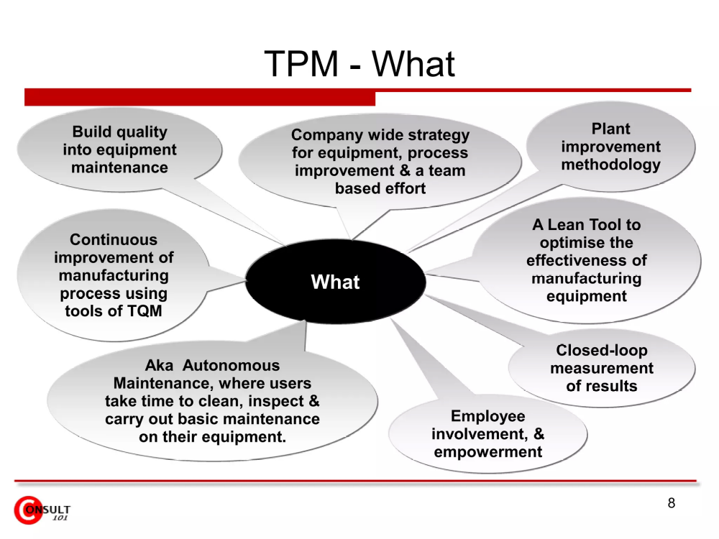
TPM - What

Slide 7
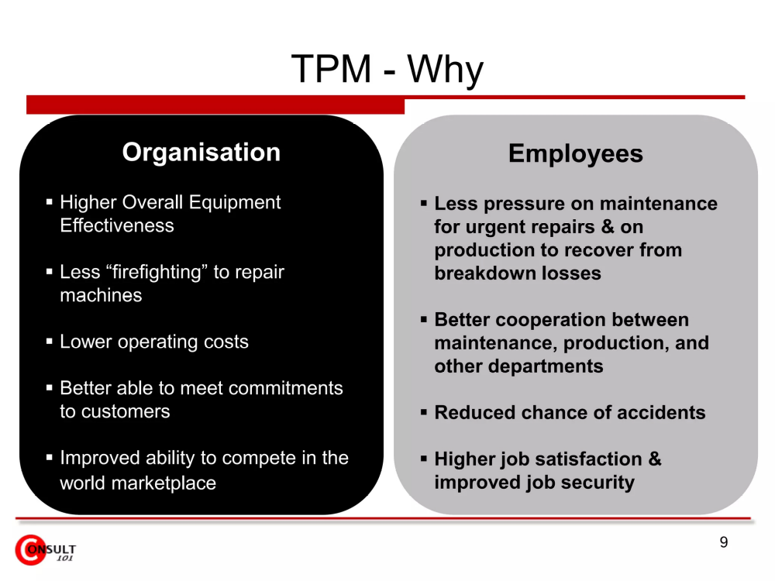
TPM - Why

Slide 8
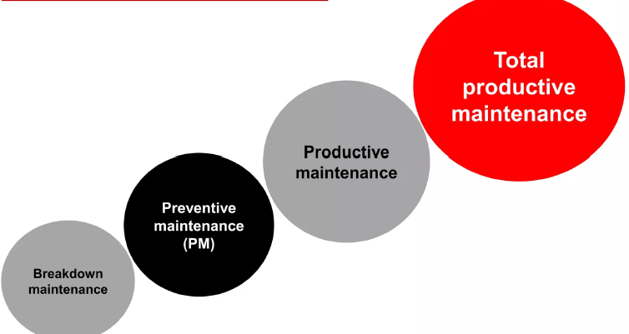
TPM - Evolution

Slide 9
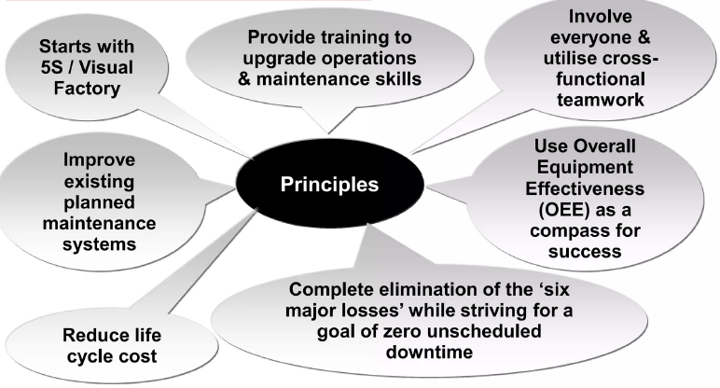
TPM - Principles

Slide 10
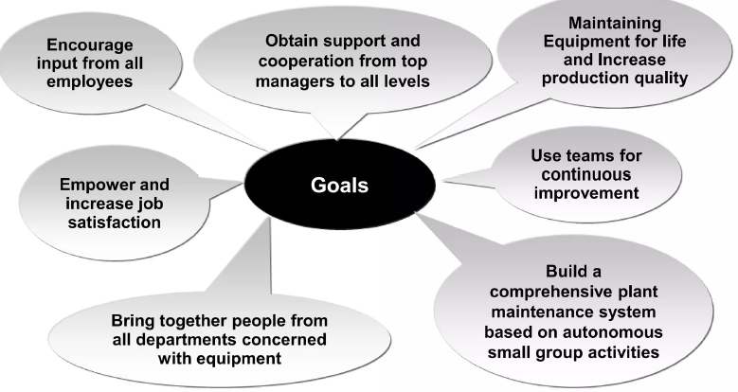
TPM - Goal

Slide 11
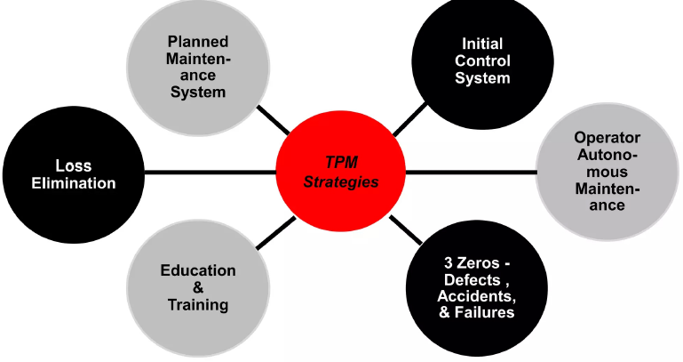
TPM - Strategies

Slide 12
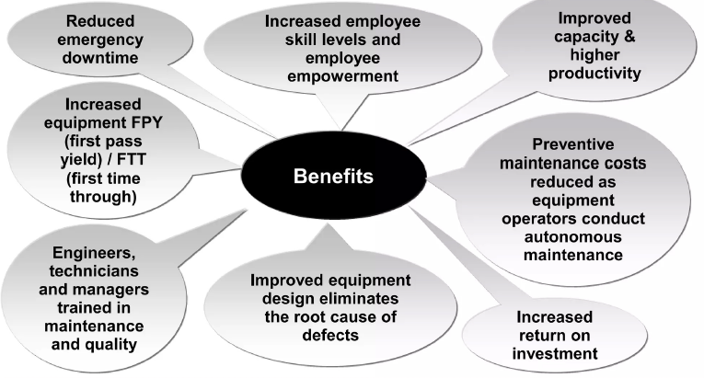
TPM - Benefits

Slide 13
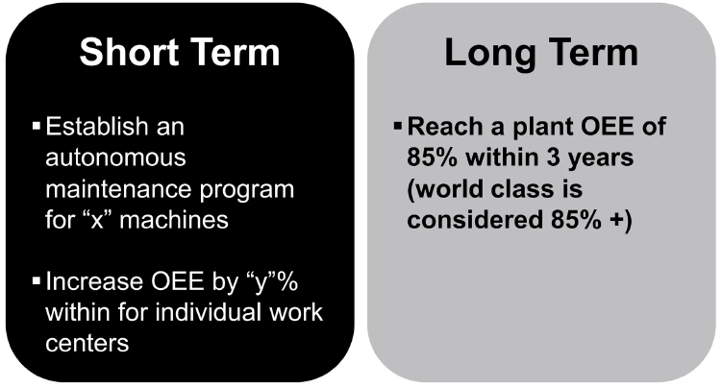
TPM - Measures

Slide 14
TPM, TQM Similarities
Employees empowered to initiate action
Ongoing, continuous process improvement
Both requires Senior Management commitment
Lon term outlook, TPM take time to implement & sustain

Slide 15
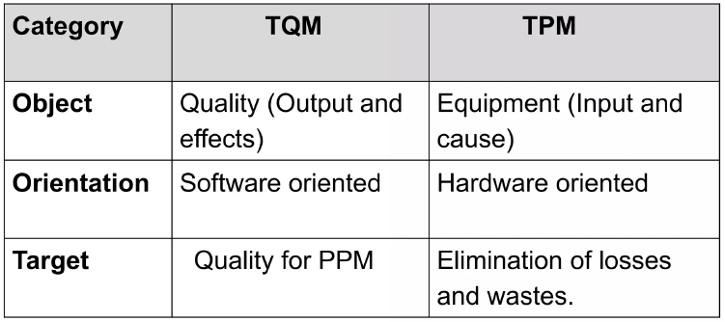
TPM & TQM Differences

Slide 16
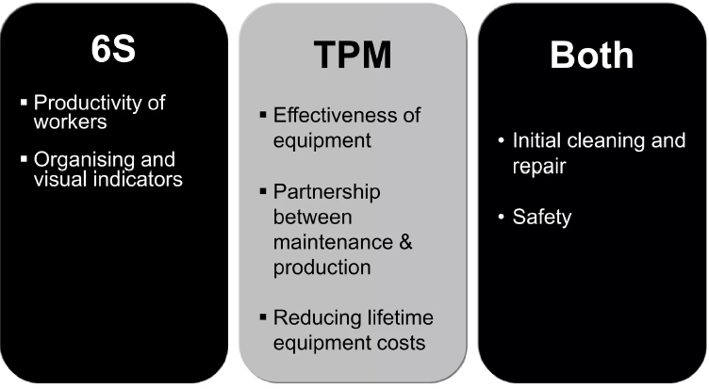
TPM & 6S

Slide 17
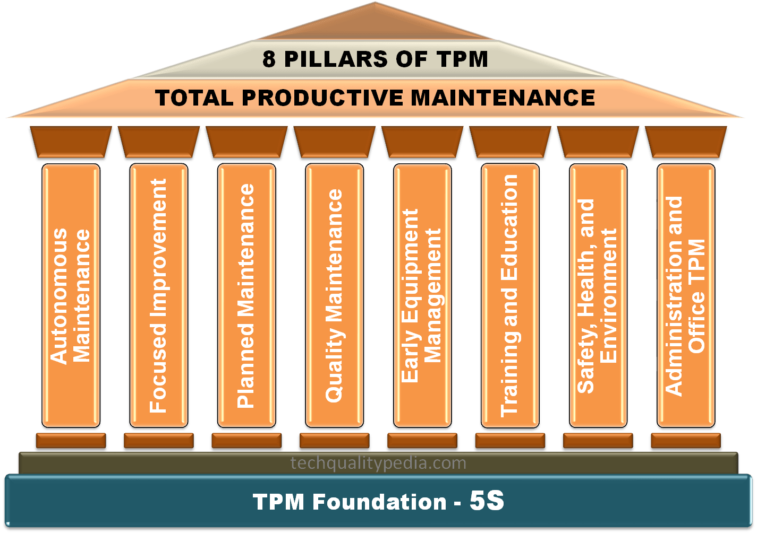
TPM - Pillars

Slide 18
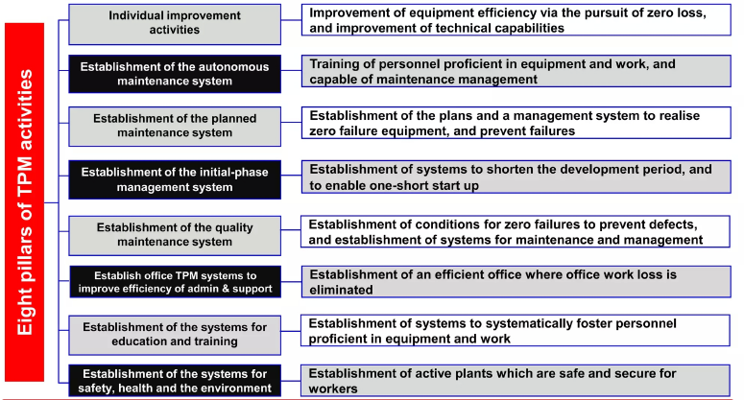
Aim – Each TPM Activity Pillar

Slide 19
OEE (Overall Equipment Effectiveness)
OEE (Overall Equipment Effectiveness) is a metric that identifies the percentage of planned production time that is truly productive.
It was developed to support TPM initiatives by accurately tracking progress towards achieving “perfect production”.
An OEE score of 100% is perfect production.
An OEE score of 85% is world class for discrete manufacturers.
An OEE score of 60% is fairly typical for discrete manufacturers.
An OEE score of 40% is not uncommon for manufacturers without TPM and/or lean programs.

Slide 20
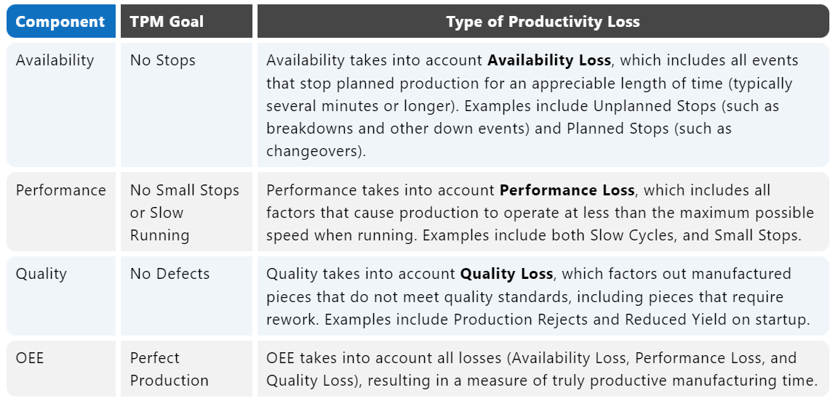
OEE (Overall Equipment Effectiveness)

Slide 21
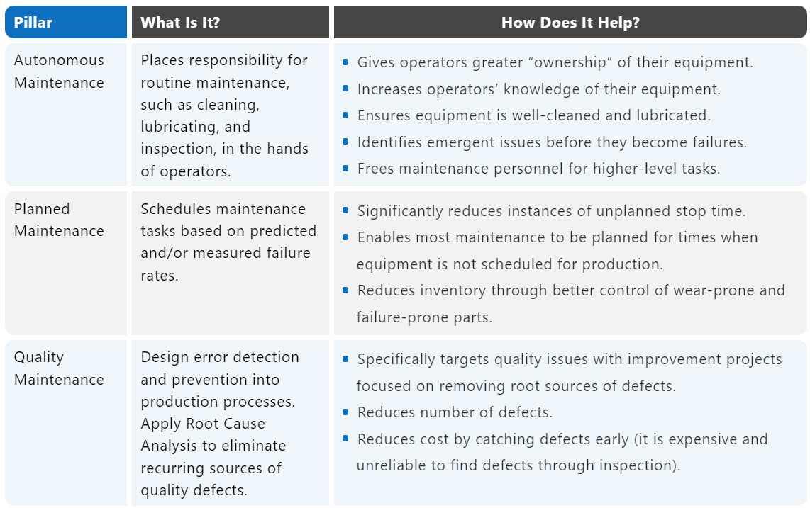
8 pillars of TPM

Slide 22
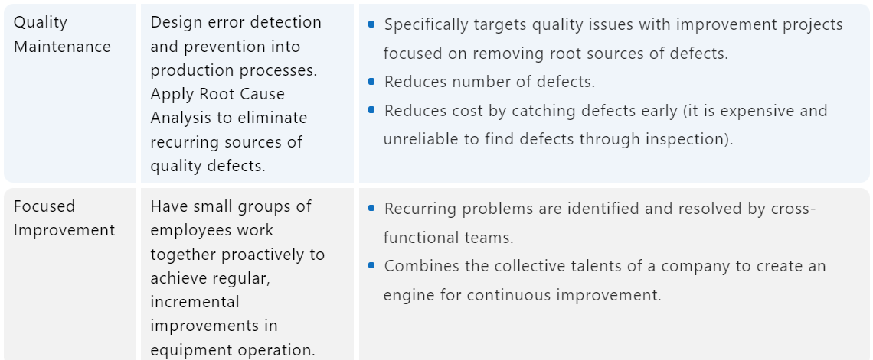
8 pillars of TPM (cont..)

Slide 23
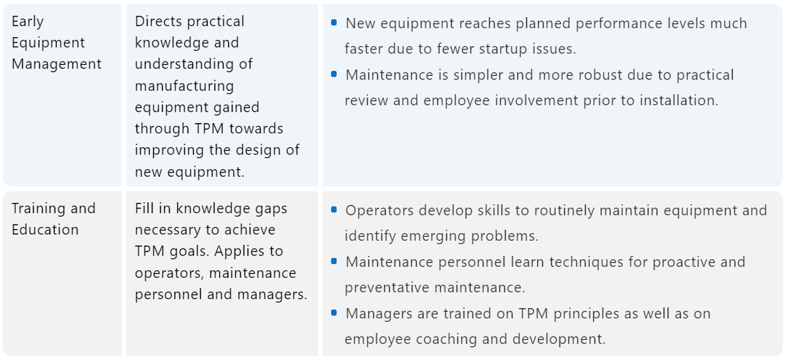
8 pillars of TPM (cont..)

Slide 24
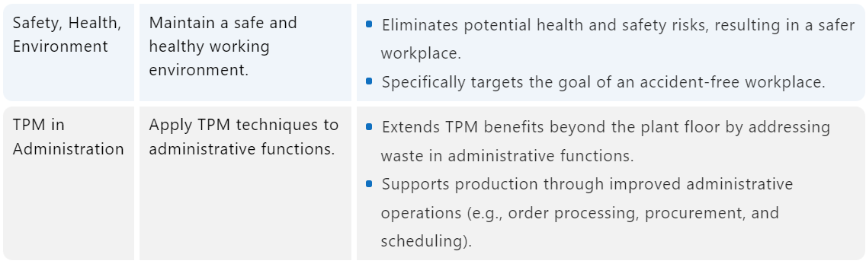
8 pillars of TPM (cont..)

Slide 25
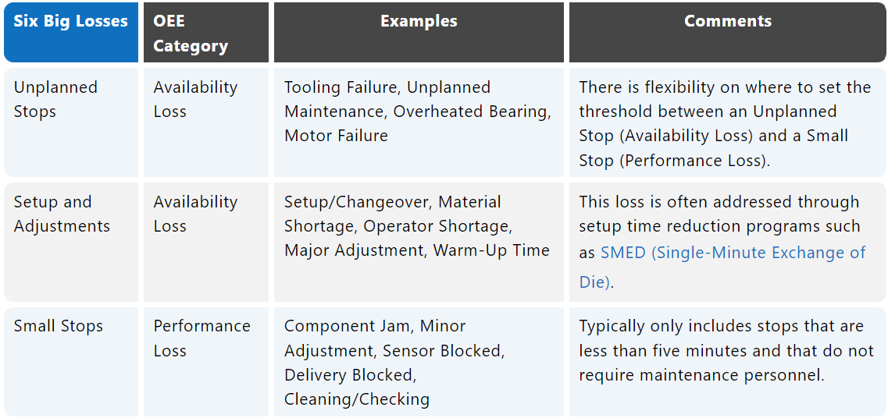
6 Major losses

Slide 26
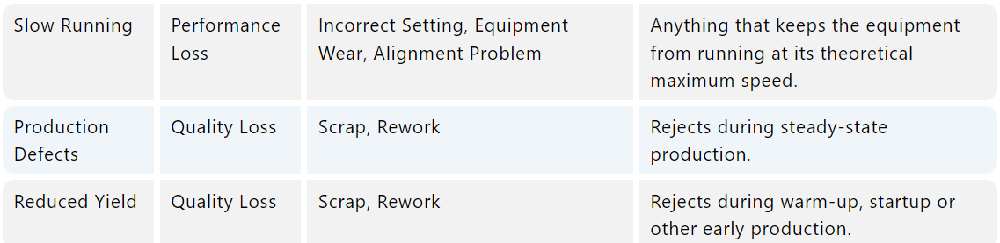
6 Major losses

Slide 27
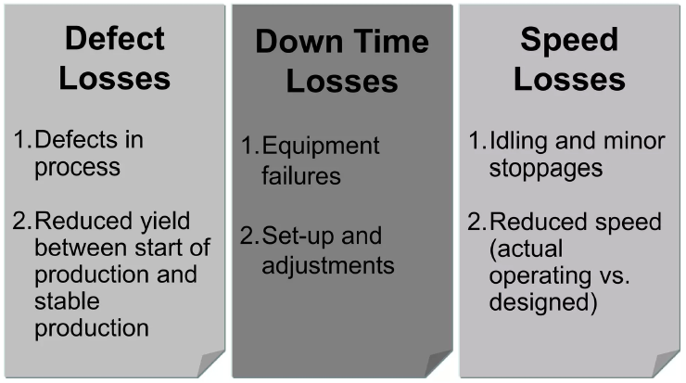
Losses / Waste – 6 Major Losses

Slide 28
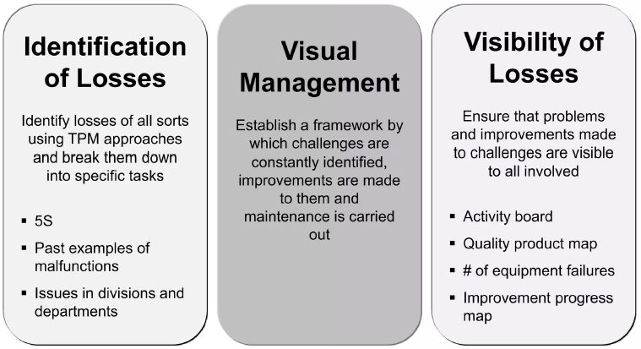
Three Zeros

Slide 29
THANK YOU!!!

